Slide 1


Generative AI
Full Stack Developer
01

Slide 2
Course B : RAG
Retrieval Augmented Generation
02

Slide 3
03 - Implementing RAG Systems
Combining Retrieval and Generation in One System
03

Slide 4





Why RAG Matters?
LLMs can hallucinate They make up information when uncertain, producing plausible but incorrect answers.
Without RAG "What's our parental leave policy?" "Most companies offer 6-8 weeks of parental leave, so I believe that would be your policy too."
RAG grounds answers in real knowledge Retrieves relevant information first, then generates answers based on that information.
With RAG "What's our parental leave policy?" "According to section 3.2 of your HR policy,
employees are entitled to 12 weeks of paid
parental leave after 1 year of employment."
Example Prompt: “What's in our company's HR policy?” LLM Response:
Without RAG = educated guess
With RAG = exact answer from policy
04

Slide 5










RAG Workflow
Encode docs with Gemini embeddings
Retrieve chunks
Generate grounded answer
Store in FAISS
Feed to LLM
for processing
Convert document text into vector representations that capture semantic meaning.
Index embeddings in FAISS for efficient similarity search and retrieval
Find most relevant document passages based on query similarity.
Combine query with retrieved passages to create context rich prompt.
LLM produces responses based on retrieved information rather than hallucinating.
05

Slide 6
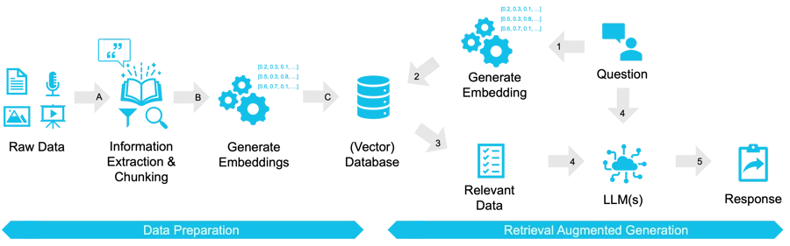
RAG System - Architecture
End-to-End Pipeline The RAG system integrates multiple components to retrieve and generate accurate information.
Data Flow Documents are encoded as embeddings, stored in vector indices, retrieved when relevant, and used to ground the LLM's responses.
Modular Design Each component can be optimized independently, allowing for flexible implementation across different use cases and domains
06

Slide 7
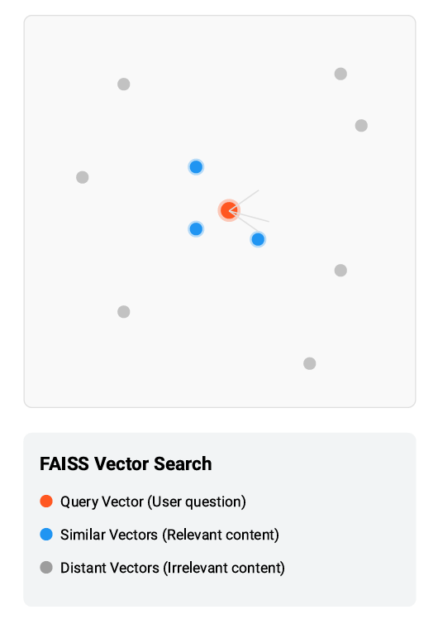



FAISS – Vector Search Engine
Fast AI Similarity Search FAISS = Facebook AI Similarity Search:
a library for efficient similarity search and clustering of dense vectors.
Scalable Vector Search Finds top-matching chunks from millions of documents in milliseconds through optimized indexing.
Key Features
Billion-scale vector similarity search
Efficient nearest neighbor algorithms
GPU acceleration for faster processing
07

Slide 8
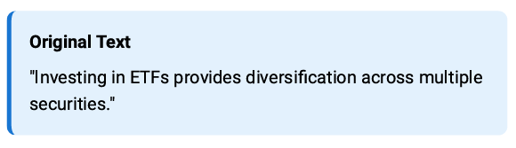


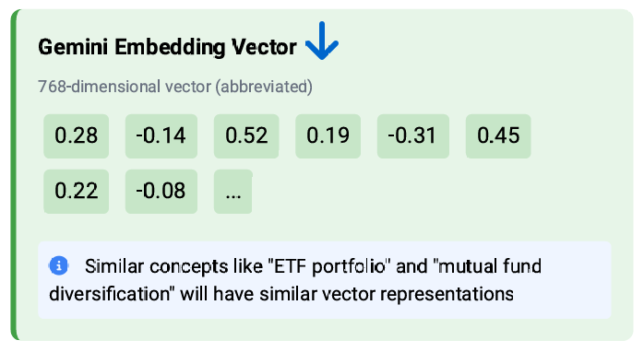

Gemini Embeddings
Converts text → vectors Transforms text documents and queries into numerical vector representations that computers can process efficiently.
Captures semantic meaning Similar concepts appear close together in vector space, even when using different words or phrasing.
Why Gemini? Reliable, optimized embeddings with state-of-the-art performance.
High-dimensional representations (up to 768 dimensions)
Context-aware understanding of language
Optimized for retrieval tasks
08

Slide 9
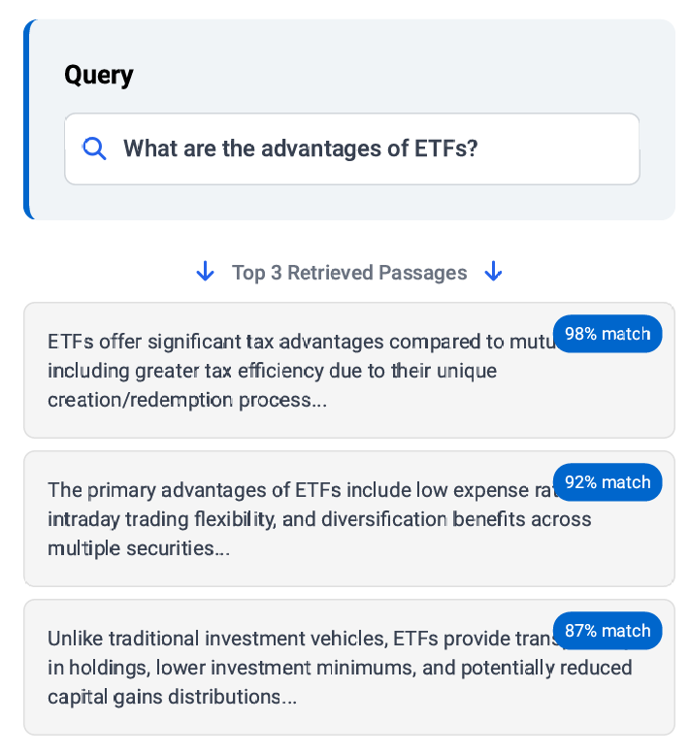

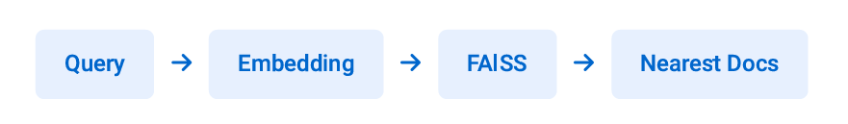
Retrieval Step
Query to Documents Process
The retrieval step transforms user queries into embeddings, then finds the most semantically similar documents in the vector database.
Example
Query: "ETF advantages"
System retrieves top-3 passages containing relevant information about ETF benefits, tax advantages, and trading flexibility.
09

Slide 10
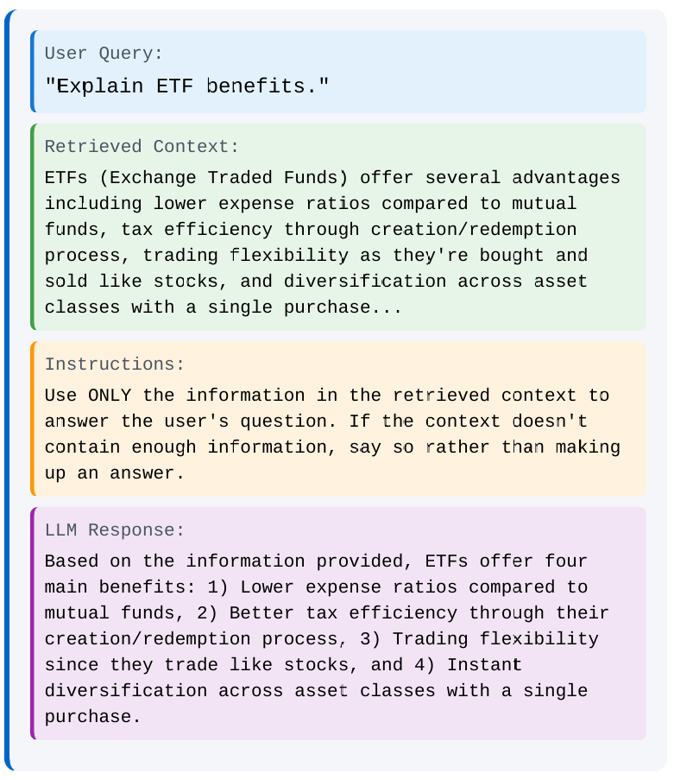



Feeding into LLM
Combining Components
Merge user query with retrieved text chunks into a structured prompt that the LLM can process effectively.
Prompt Structure
Create clear separation between:
User query
Retrieved context
Instructions for LLM
Benefits
Well-structured prompts improve accuracy and reduce hallucinations by giving the LLM clear boundaries and reliable source material.
10

Slide 11
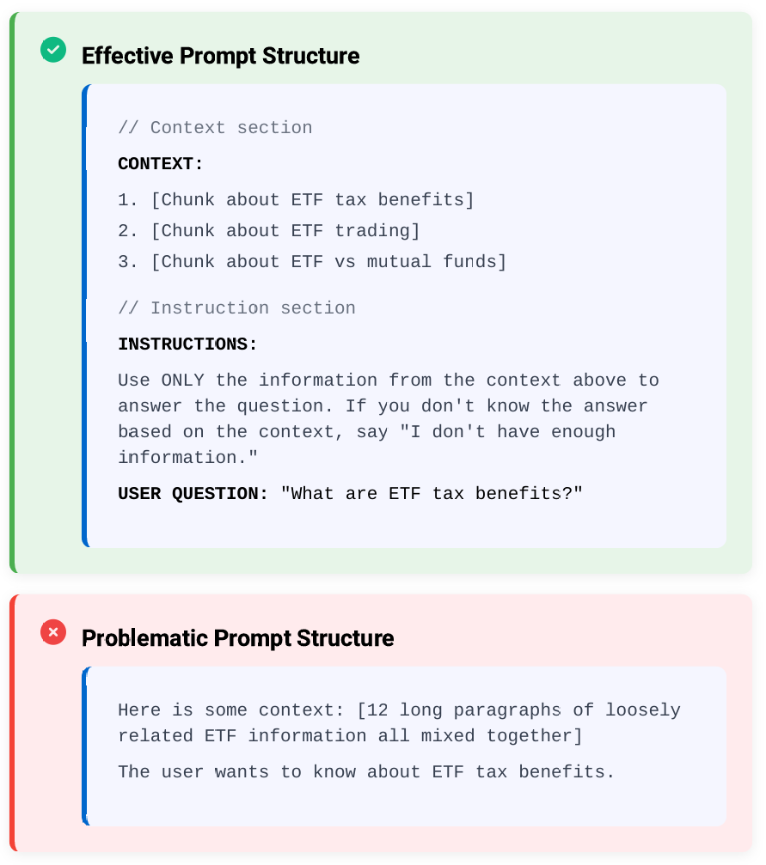



RAG Prompt Engineering Tips
Separate retrieved context clearly
Use clear formatting to distinguish between retrieved information and user query in your prompt.
Tell LLM: "Use only provided context"
Explicit instructions prevent the model from adding outside information and reduce hallucinations.
Avoid too many chunks
More isn't always better - focus on quality and relevance of retrieved content to stay within token limits.
11

Slide 12
Practice
12

Slide 13

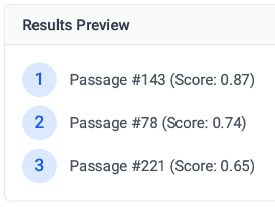

Practice 1: Retrieval with FAISS
Task
Run a sample query: "Mutual fund tax benefits"
Follow the steps below to complete this exercise
Procedure: Use FAISS search with Gemini embeddings
Inspect top-3 passages Review the retrieved passages and their relevance scores:
import faiss
from google.generativeai import embed_content
# Convert query to embedding vector
query_embedding = embed_content(query="Mutual fund tax benefits")
# Search FAISS index
D, I = index.search(query_embedding, k=3)
Reflection Consider the Following questions:
Were the retrieved passages relevant to the query?
Did the embedding capture the semantic meaning correctly?
How would you improve the retrieval results?
13

Slide 14
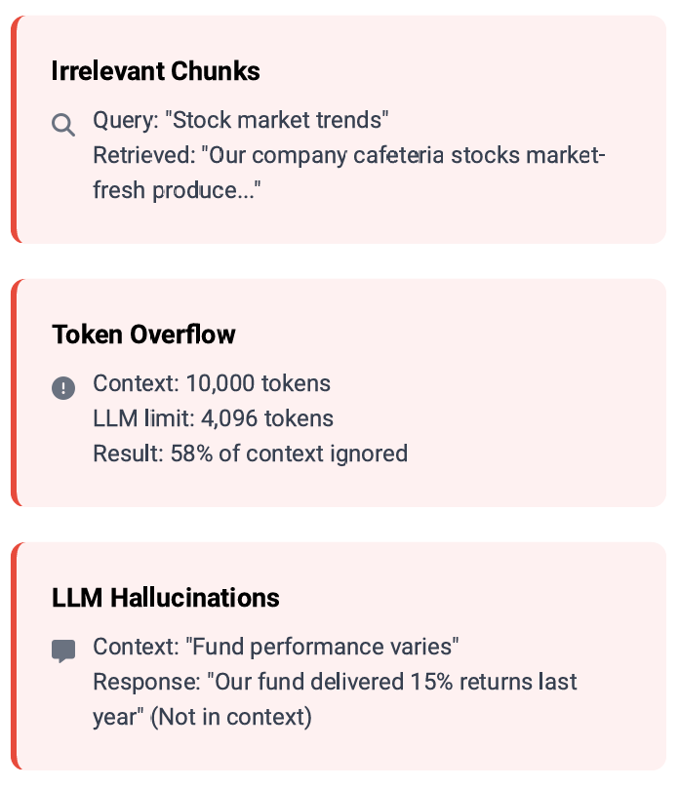


Common Issues in RAG
Irrelevant chunks
Retrieval system may return passages that aren't relevant to the query, leading to off-topic responses.
Token overflow Retrieved chunks may exceed LLM context window limits, causing important information to be truncated.
LLM hallucinations
LLMs may still generate inaccurate information even with retrieved context, especially when context is ambiguous.
14

Slide 15
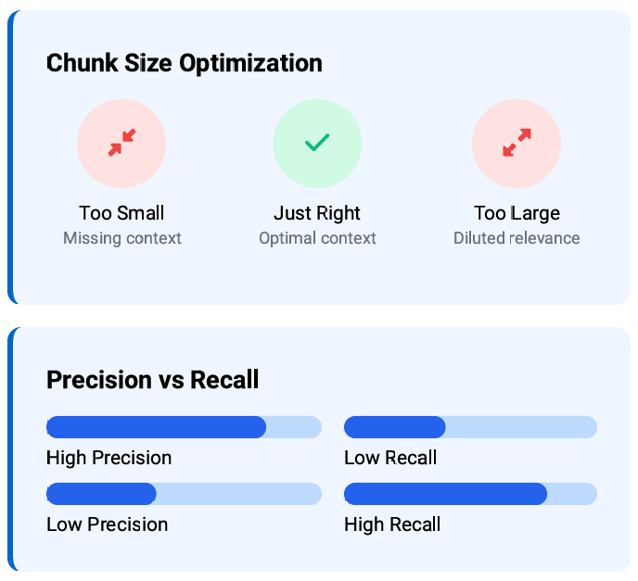



Improving Retrieval
Right chunk size matters
Too small: loses context. Too large: dilutes relevance. Find the optimal balance (typically 100-1000 tokens) for your use case.
Metadata filtering
Enhance retrieval by filtering on document properties: date, source, author, category, etc. Narrows search space for more relevant results.
Balance precision vs recall
Precision: fewer but more relevant results. Recall: more results to avoid missing information. Adjust based on your application needs.
15

Slide 16
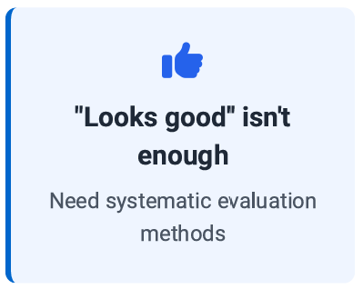
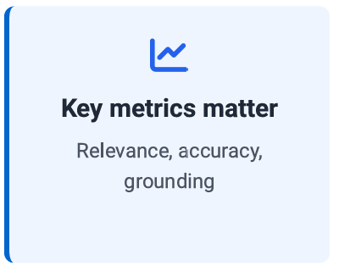
Why Evaluate RAG?
Moving beyond qualitative assessment to measurable performance
Vs.
16

Slide 17
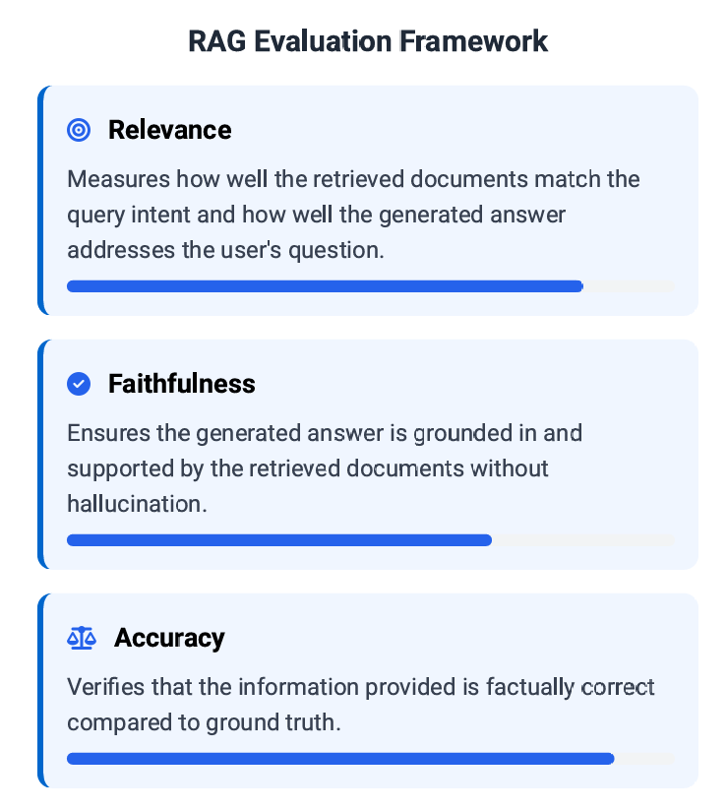


Evaluation Techniques
Human Review
Expert evaluators assess responses for:
Quality and helpfulness
Factual correctness
Alignment with retrieved context
Automatic Metrics Quantitative measures to evaluate RAG system performance:
Relevance - Does the response address the query?
Faithfulness - Is the response consistent with retrieved context?
Accuracy - Is the information factually correct?
17

Slide 18
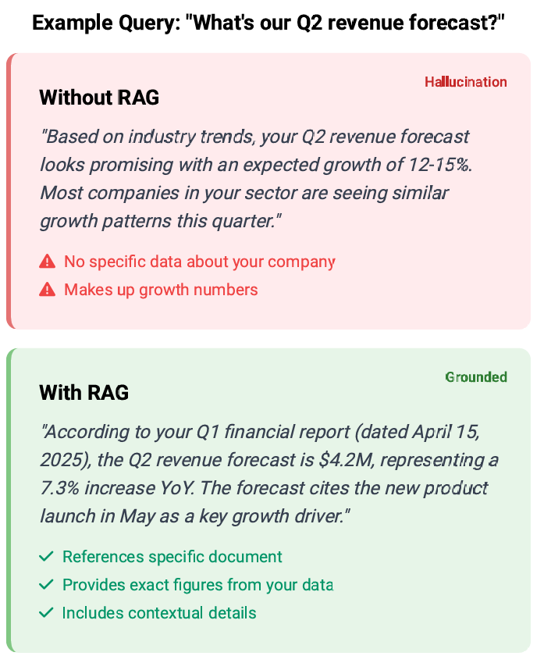


Evaluation Examples
Side-by-Side Evaluation Compare the quality and accuracy of answers from systems with and without RAG integration:
Without RAG
Generates vague, potentially hallucinated information
Generic answers not specific to your data
May confidently state incorrect information
Outdated or incomplete knowledge
With RAG
Produces specific, grounded answers from your data
Cites specific sources and references
Acknowledges limitations when information is missing
Stays current with your latest documents
18

Slide 19
Practice 2: Evaluate RAG Answers
Task
Compare two answers (with vs without RAG) for the query: "What are the key investment strategies in our 2025 financial outlook?". Judge which answer performs better across three evaluation criteria
Without RAG The key investment strategies in our 2025 financial outlook include diversification
across asset classes, focus on emerging markets, investment in technology sectors,
particularly AI and renewable energy, and maintaining liquidity for potential market
corrections. We recommend a balanced approach between stocks and bonds with
approximately 60/40 allocation depending on risk tolerance.
With RAG According to our 2025 Financial Outlook document (updated March 2025), our key
investment strategies are: (1) Defensive positioning in high-quality bonds (40%), (2)
Selective exposure to value stocks in healthcare and consumer staples (35%), (3)
Strategic allocations to gold and inflation-protected securities (15%), and (4) Cash
reserves for opportunistic purchases during volatility (10%). The document
specifically cautions against overexposure to emerging markets due to projected
currency instabilities.
20

Slide 20



Evaluation Criteria: Relevance Does the answer directly address the query about investment strategies? Accuracy Does the answer contain correct information from company documents? Faithfulness to Context Is the answer grounded in the provided context without hallucination?
Reflection Questions:
Which answer provides more specific investment allocation percentages?
Which answer appears to reference actual company documentation?
Which answer provides insights that could only come from company-specific knowledge?
21

Slide 21

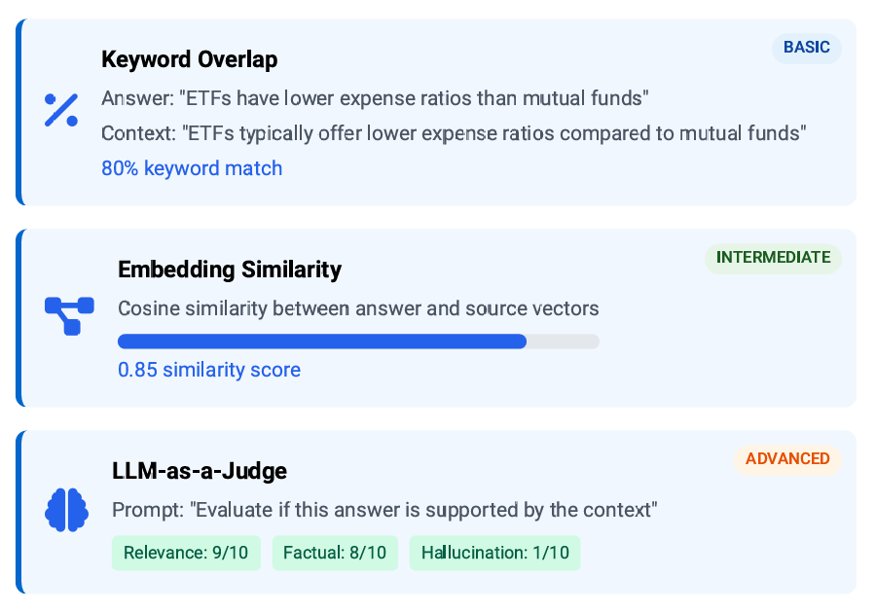

Automating Evaluation
Keyword overlap
Compares words in the answer with words in the retrieved context.
Simple but effective baseline metric.
Embedding similarity
Measures semantic closeness between response and source using vector embeddings. Captures meaning beyond exact words.
LLM-as-a-judge (advanced)
Uses another LLM to evaluate quality across multiple dimensions like
relevance, factual accuracy, and hallucination detection.
22

Slide 22
2. Practice
19

Slide 23
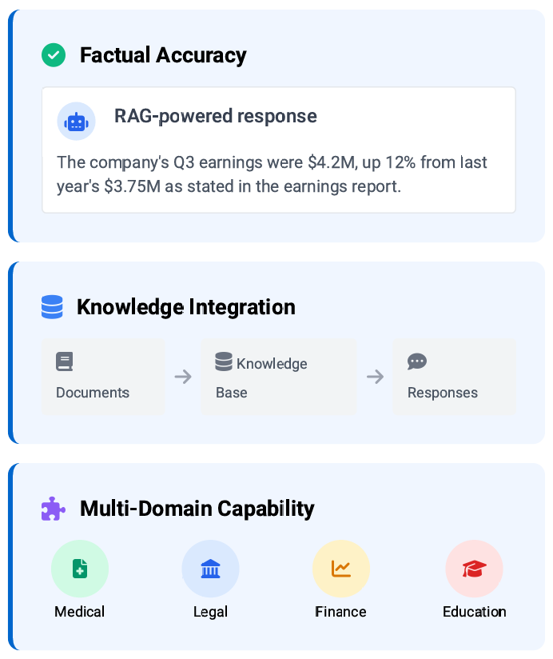



Benefits of RAG
Reduces hallucinations
Grounds LLM responses in retrieved knowledge rather than generating information from parameters alone.
Keeps answers updated
External knowledge base can be regularly updated without retraining the entire model.
Flexible across domains
Same architecture works for any knowledge domain by simply changing the document corpus.
23

Slide 24
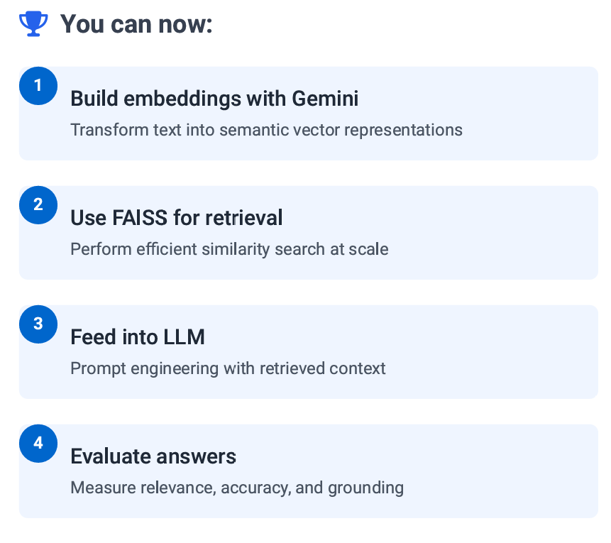
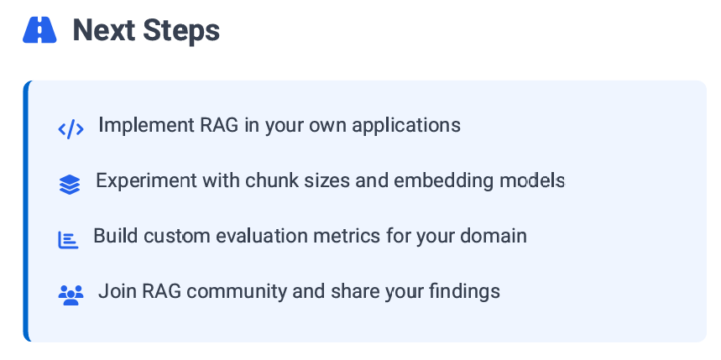
Wrap-Up & Next Steps
Project:
Build a Document Retriever Search Engine from scratch.
Mini Project: Implement a Q&A bot over a PDF knowledge base.
24

Slide 25
Q/A
25

Slide 26
Thanks
26

